Slide 1
Introduction to Metagenomics
Data Science platform
DTU – Biosustain
Spring Courses 11th June 2025

Slide 2
Impact of microbiome studies on health studies
Achievement | Description | Citation
Human Microbiome Mapping | The Human Microbiome Project (HMP) mapped microbial communities across various body sites, revealing extensive microbial diversity in healthy individuals. | NIH Human Microbiome Project
Microbiome and Chronic Diseases | Established associations between gut microbiota and conditions like obesity, type 2 diabetes, IBD, cardiovascular disease, and autoimmune disorders. | NIH Human Microbiome Project
Gut-Brain Axis | Demonstrated that gut microbes influence mood, anxiety, and cognitive functions, contributing to understanding of disorders like depression, autism, and Parkinson’s disease. | NIH Human Microbiome Project
Fecal Microbiota Transplantation (FMT) | FMT has shown high efficacy in treating recurrent Clostridioides difficile infections, with success rates up to 90%. | eBioMedicine, The Lancet
Microbiome and Drug Response | Studies indicate that gut bacteria can modulate the efficacy and toxicity of drugs, including chemotherapy and immunotherapy agents. | https://pubmed.ncbi.nlm.nih.gov/36309208/

Slide 3
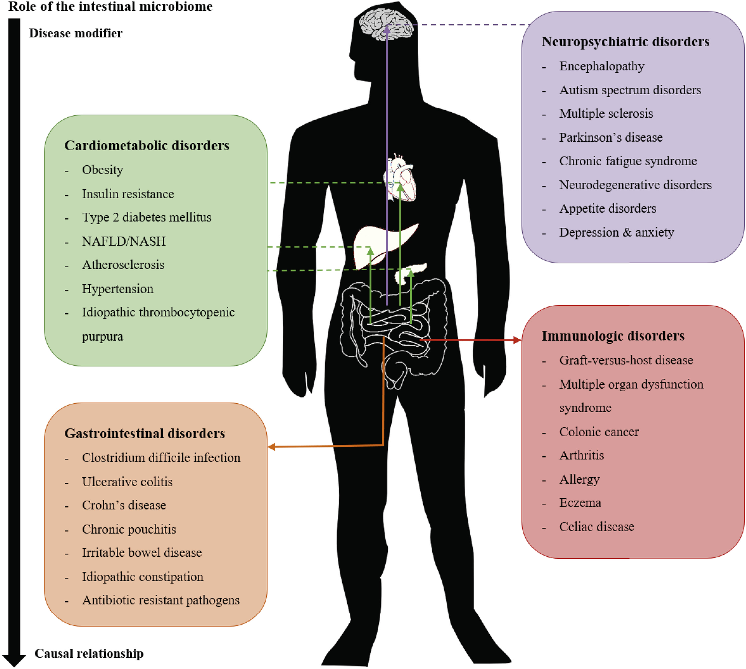
Notes:
associations between the intestinal microbiome and disease. At this moment, for most diseases it is not known whether the microbiota is causally related or merely a result of the pathophysiology.

Slide 4
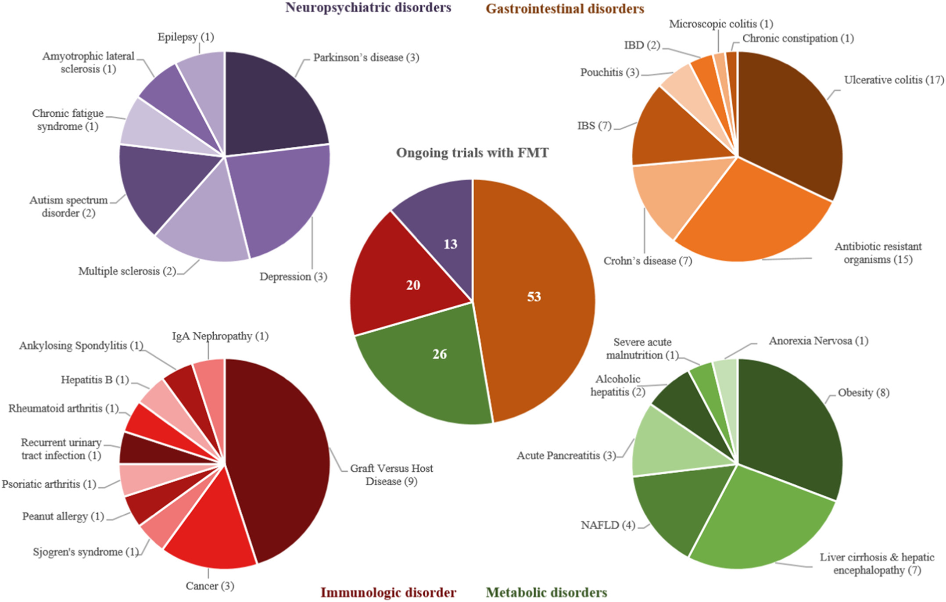
Notes:
overview of ongoing trials in which the efficacy of FMT is tested for a range of diseases

Slide 5
Impact of microbiome studies on Environmental Science
Achievement | Description | Citation
Soil and Plant Microbiomes | Advanced understanding of plant-microbe interactions in the rhizosphere, leading to improved soil fertility and plant growth through biofertilizers and biopesticides. | Plant Microbiome - Wikipedia
Bioremediation | Utilization of microbes to clean up environmental pollutants like oil spills, heavy metals, and plastics, enhancing wastewater treatment processes. | Wired https://www.nature.com/articles/s41467-024-51957-8
Climate Change and Carbon Cycling | Microbiome studies have revealed microbial roles in carbon sequestration and greenhouse gas emissions, aiding in climate feedback modeling. | Wired
Marine and Aquatic Ecosystems | Microbial communities regulate oceanic nutrient cycling, such as nitrogen fixation, and contribute to coral reef health and resilience. | Wired
One Health Framework | Integration of microbiome knowledge across humans, animals, and the environment supports global health efforts in disease surveillance and antimicrobial resistance. | Wired

Slide 6
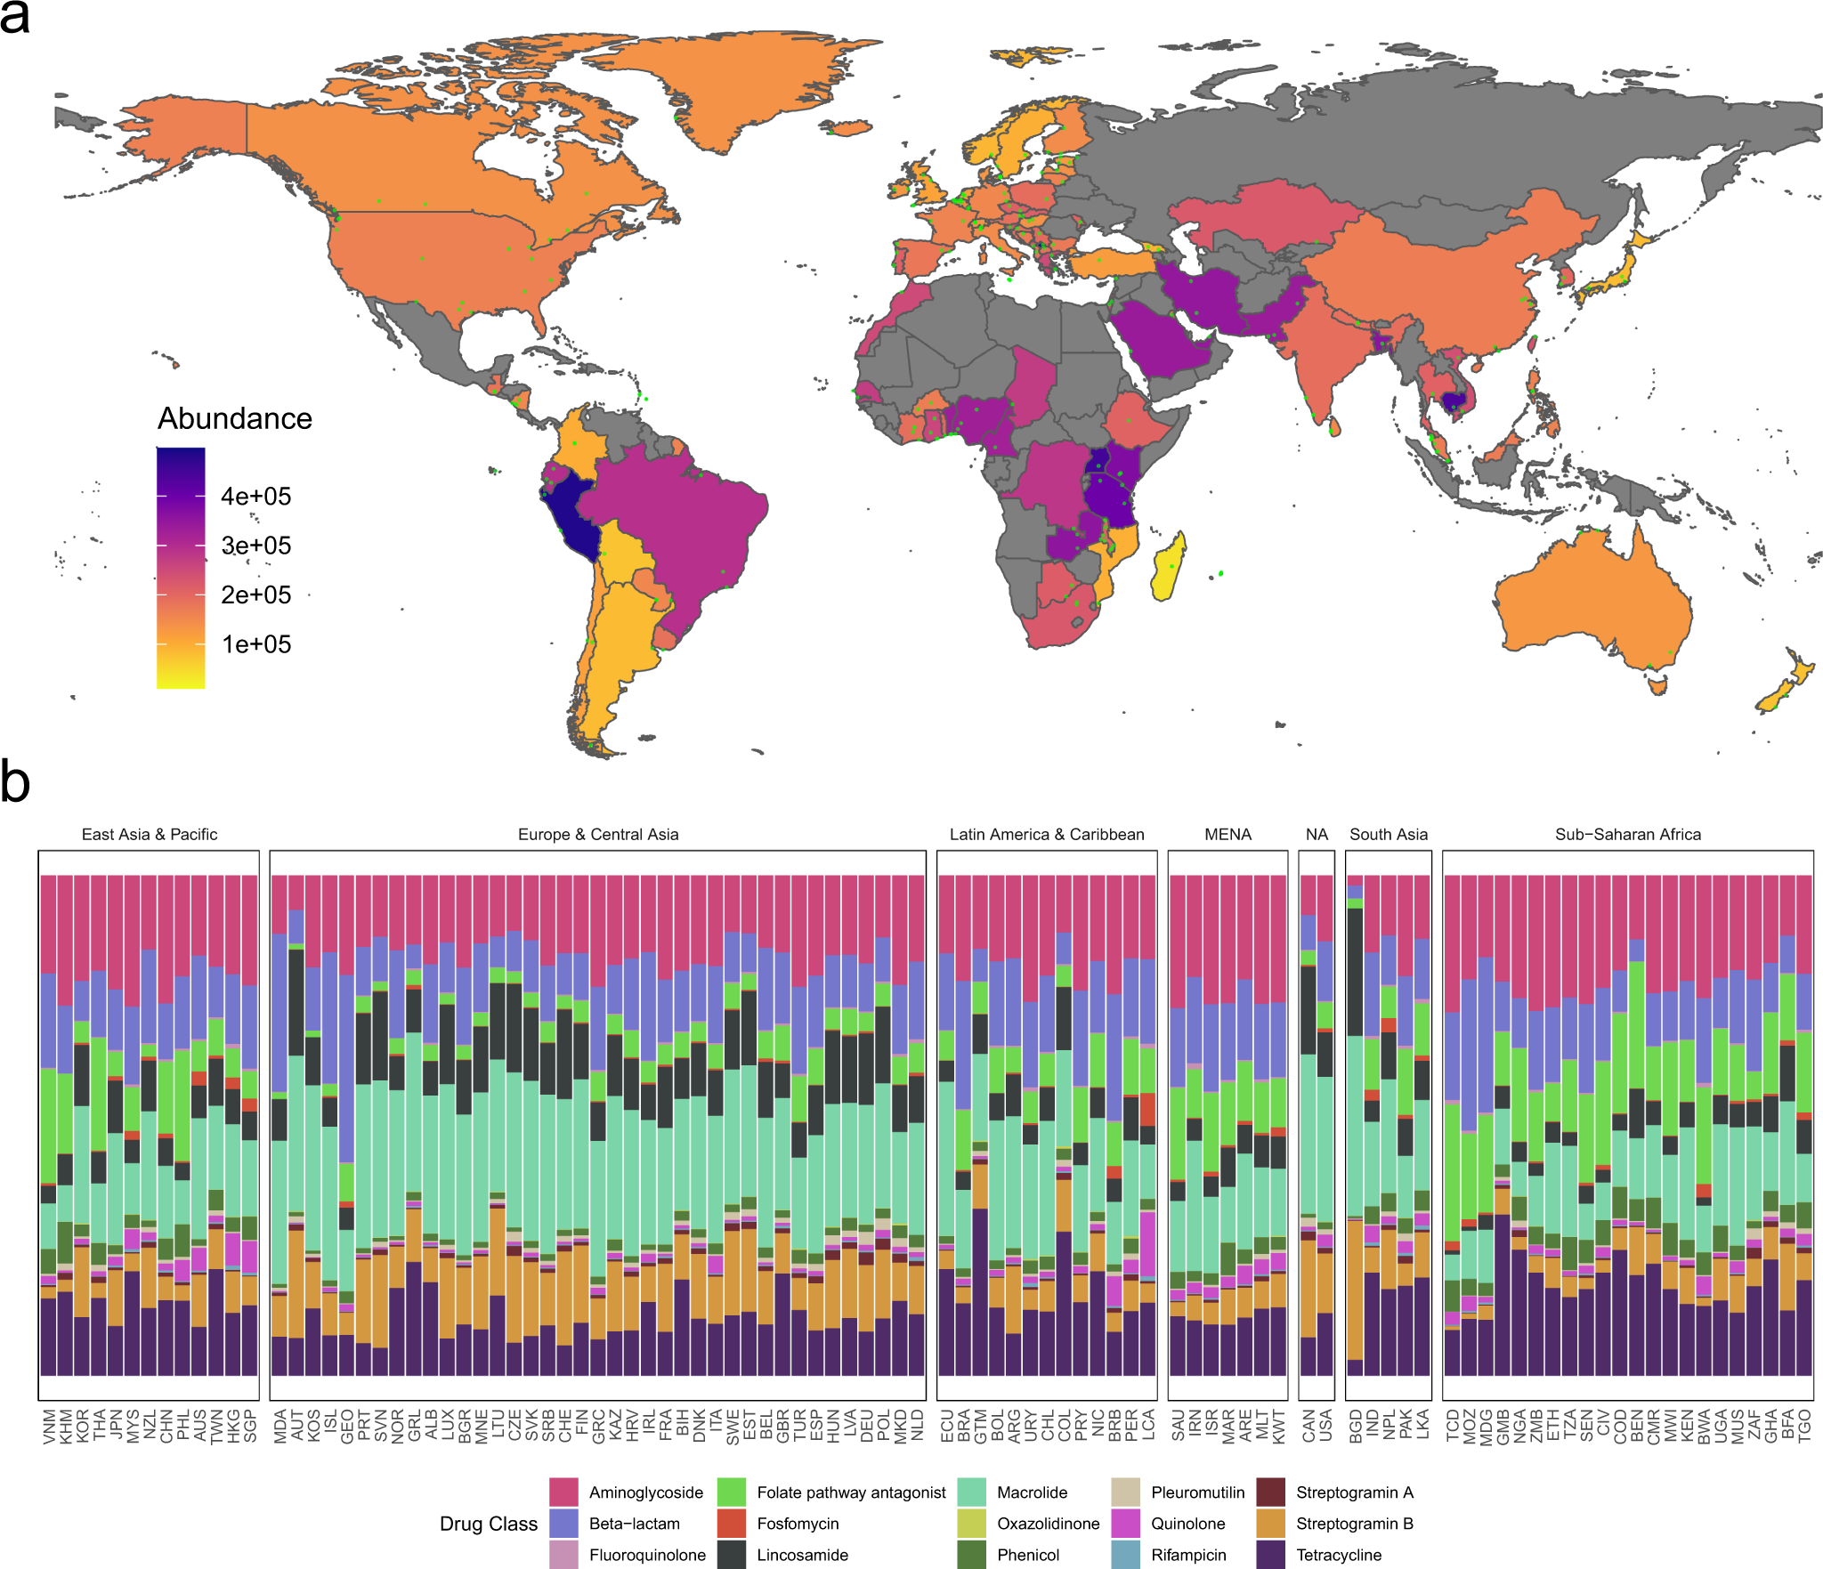
Notes:
Choropleth of the world coloured by the country-wise average total AMR load (see methods). Small green dots show unique sampling sites contributing to the average. Some areas are disputed, and we realize that exact border placement is difficult due to geopolitical issues. b Stacked bar chart of relative abundances per drug class per country. Each panel represent countries in a World Bank region and is ordered by the Shannon diversity of class-level AMR.

Slide 8
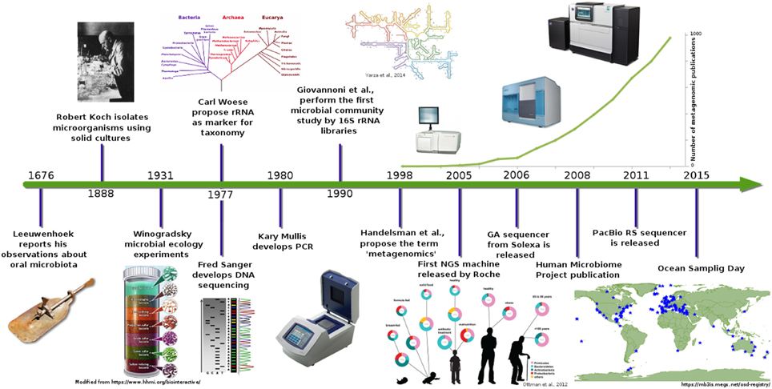
Timeline of microbiome science

Slide 9


Microbiome definition
Microbiome refers to an organism community in an specific environment
Organism products:
Genes
Proteins
Pathways
Metabolites
Inhabitants:
Bacteria
Archaea
Fungi
Viruses
Protozoa
…
Environment:
Soil
Ocean
Wastewater plant
Gut
Skin
…
In contrast to a monoculture (all cells belong to one organism), in a microbiome we have cells of many different organisms → microbial community

Slide 10

What a microbiome study usually answer
Who is in the samples?
What is the relative proportion of the different members
What is the toal abundace (number of cells) (by absolute abundace)
How abundant are bacteria, archaea, protozo, virus,…
How diverse is the microbial community
How evenly distributed is it?
What are these organisms doing?
What functions potentially do they perform
What substrates they consume?
What metabolites they produce?
How do they perform their activities?
Which genes and/or pathways are present?z

Slide 11
What is Metagenomics?
Study of the genetic material sampled directly from the environment (fecal, skin, soil, marine samples …)
Bypasses the need of culturing organisms – many of the organisms that we characterized ca not even be coltured
Uses high-throughput sequencing to analyze microbial diversity, function, and interactions

Slide 12
Main applications
🧬 Microbial Diversity Analysis: Who’s there? (e.g., in soil, gut, ocean)
🦠 Disease & Health Research: Microbiome links to health (e.g., gut-brain axis, chronic diseases)
♻️ Environmental Monitoring: Pollution detection, bioremediation
🌾 Agriculture & Soil Health: Plant-microbe interactions, soil fertility
🍺 Industrial Biotechnology: Novel enzymes, biofuels, fermentation
💊 Antibiotic Resistance Surveillance: Track resistance genes in the environment

Slide 13

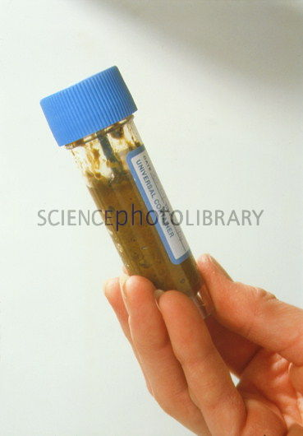
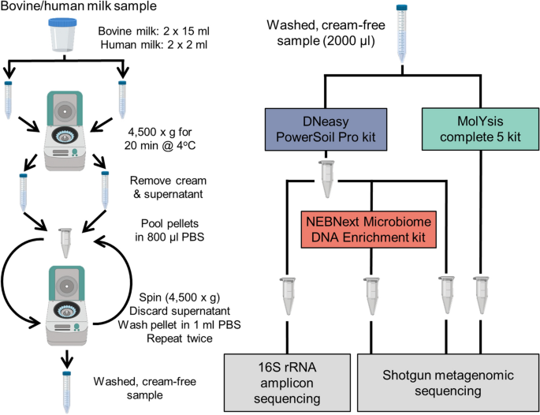
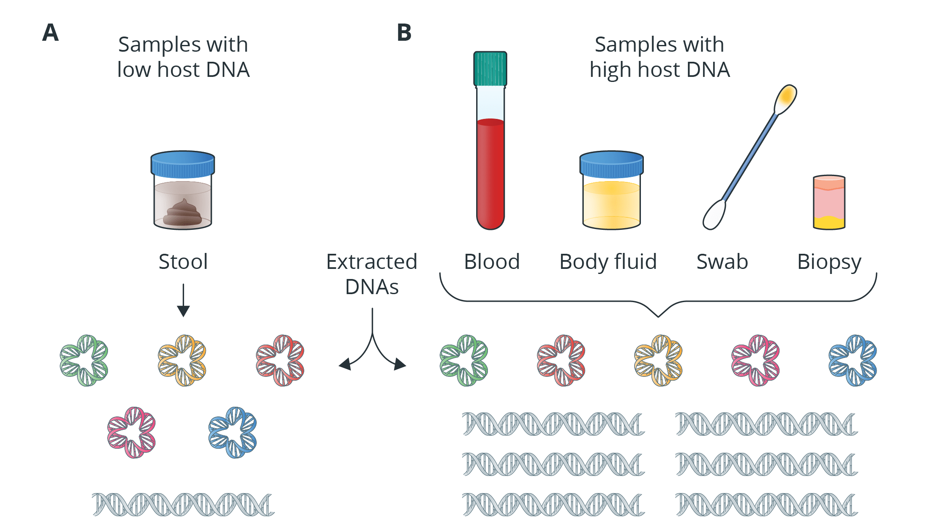
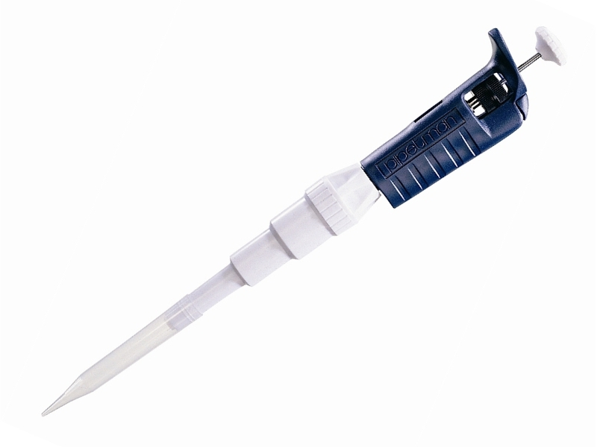
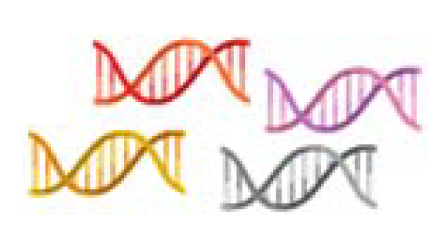

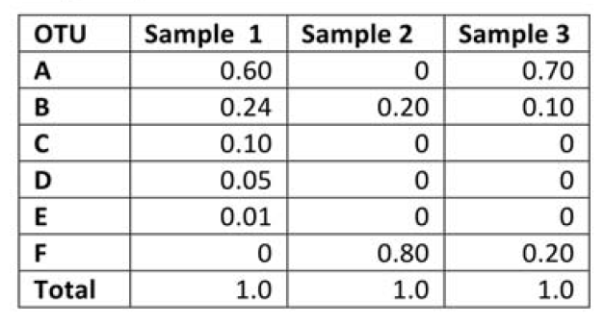

Experimental design
DNA Sequencing
DNA Sampling
DNA Storage
DNA Extraction
Microbiome abundances
Taxonomical and functional chracterization

Slide 14
Sample collection
To obtain a representative and uncontaminated snapshot of a microbial community in a specific environment (e.g., gut, soil, water, skin,…)
Sterile tools and containers need to be used
Microbial DNA can degrade rapidly. A good preservation ensures the microbial community structure remains as close to in situ as possible.
Freezing (-20 to -80C) for long-term storage
Preservation buffers if freezing is delayed
Process quickly after sampling to reduce DNA degradation and community shifts if freezing is not possible
For sample transportation use cold chain logistics (ice packs, dry ice, liquid nitrogen)
Label clearly with metadata: time, location, environmental conditions, etc.
Important for downstream analysis and reproducibility

Slide 15
DNA Extraction
To obtain high-quality, unbiased, and inhibitor-free DNA from a complex matrix (e.g., soil, feces, water)
Isolate total microbial DNA from all organisms in a sample (bacteria, archaea, fungi, viruses—depending on context)
Steps:
Cell Lysis: The goal is to lyse all types of microbes, including tough ones like Gram-positive bacteria or spores
DNA Release: Kits are preferred in metagenomics for consistency, ease, and reduced contamination risk (e.g., Qiagen, Zymo, MoBio/DNeasy)
Contaminant Removal: Use specialized kits with inhibitor removal steps (e.g., PowerSoil DNA Kit)
DNA Purification: remove proteins, RNA, lipids, and inhibitors
Quantification & Quality Check
Common DNA extraction kits:
QIAGEN DNeasy PowerSoil Pro Kit
QIAGEN QIAamp PowerFecal Pro DNA Kit
ZymoBIOMICS DNA Miniprep Kit

Slide 16
Sequencing
To read the nucleotide sequences of DNA fragments extracted from a microbial community — enabling identification of who is present and what they can do
Library preparation: DNA must be fragmented and tagged with adapters for compatibility with sequencing platforms.
Include negative and positive controls (e.g., mock communities)
Choose depth wisely: deeper for complex samples (e.g., soil, strain resolution, SNVs), lighter for simple ones
https://www.youtube.com/watch?v=HMyCqWhwB8E

Slide 17
Platforms
Platform | Features | Read Length | Use Case
Illumina | High accuracy, short reads | ~150–300 bp | Most common for shotgun & amplicon
Oxford Nanopore | Long reads, portable | up to 100 kb+ | Assembly, rare taxa detection
PacBio HiFi | Long + accurate reads | ~10–25 kb | Functional profiling, assembly
Ion Torrent | Medium throughput | ~200–400 bp | Less common but used in clinical

Slide 18


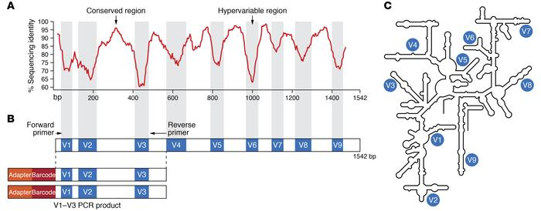
Profiling microbial communities 16S amplicon sequencing (16S rRNA sequencing)
Targets specifically 16S rRNA
amplicon
sequencing
Compare to a reference database
Abundance table
Samples
CGCCTAT
CACCTAT
CGCCTAT
CGCCTAC
CGCCTAT
Features
16S rRNA
gene
Operational taxonic Units (OTUs) – Resolution up to Genus
Inferred functions
J Clin Invest. 2022;132(7):e154944. https://doi.org/10.1172/JCI154944.

Slide 19
Profiling microbial communities Reference-based methods

Slide 20
Metagenome-assembled genomes

Slide 21
Microbiome data
Sparsity
Dinamic range
Relative vs Absolute abundace
.Compositionality

Slide 22
Absolute abundance vs relative abundance

Slide 23
Compositional data
In metagenomics, compositional data means that your microbial abundances are relative, not absolute. You're usually working with proportions or percentages of total reads per sample — not true cell counts.
Metagenomic studies of microbial communities sample a fraction of the total genomic content (sampling depth), which are then sequenced at a certain sequencing depth. Both sampling depth and sequencing depth can vary several orders of magnitude between samples. As absolute microbial counts (abundances) are normally not known, and measurements depend on sampling and sequencing depths, community compositions are represented using relative abundances. Since relative abundances are constrained (they sum to 1 in a given community), they are susceptible to compositional effects, where an increase in relative abundance of one component leads to a compositional decrease in the relative abundance of other components. Differential analysis based on relative abundances thus needs careful interpretation as compositional effect can introduce spurious differences in relative abundances while the absolute abundances are not different.

Slide 24
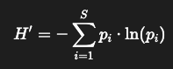
Diversity measures: Alpha diversity
Shannon index:
S = total number of species
pi = proportion of species i in the sample
Diversity within a sample
Richness: Number of unique taxa (e.g., species, OTUs, ASVs)
How many different taxa are in a sample
Shannon Index: Accounts for both richness and evenness
Interprets: Both richness and evenness (how balanced the community is)
Higher value = More diverse and evenly distributed community
Other indices: Simpson, Chao1, Faith’s PD (for phylogenetic diversity)

Slide 25
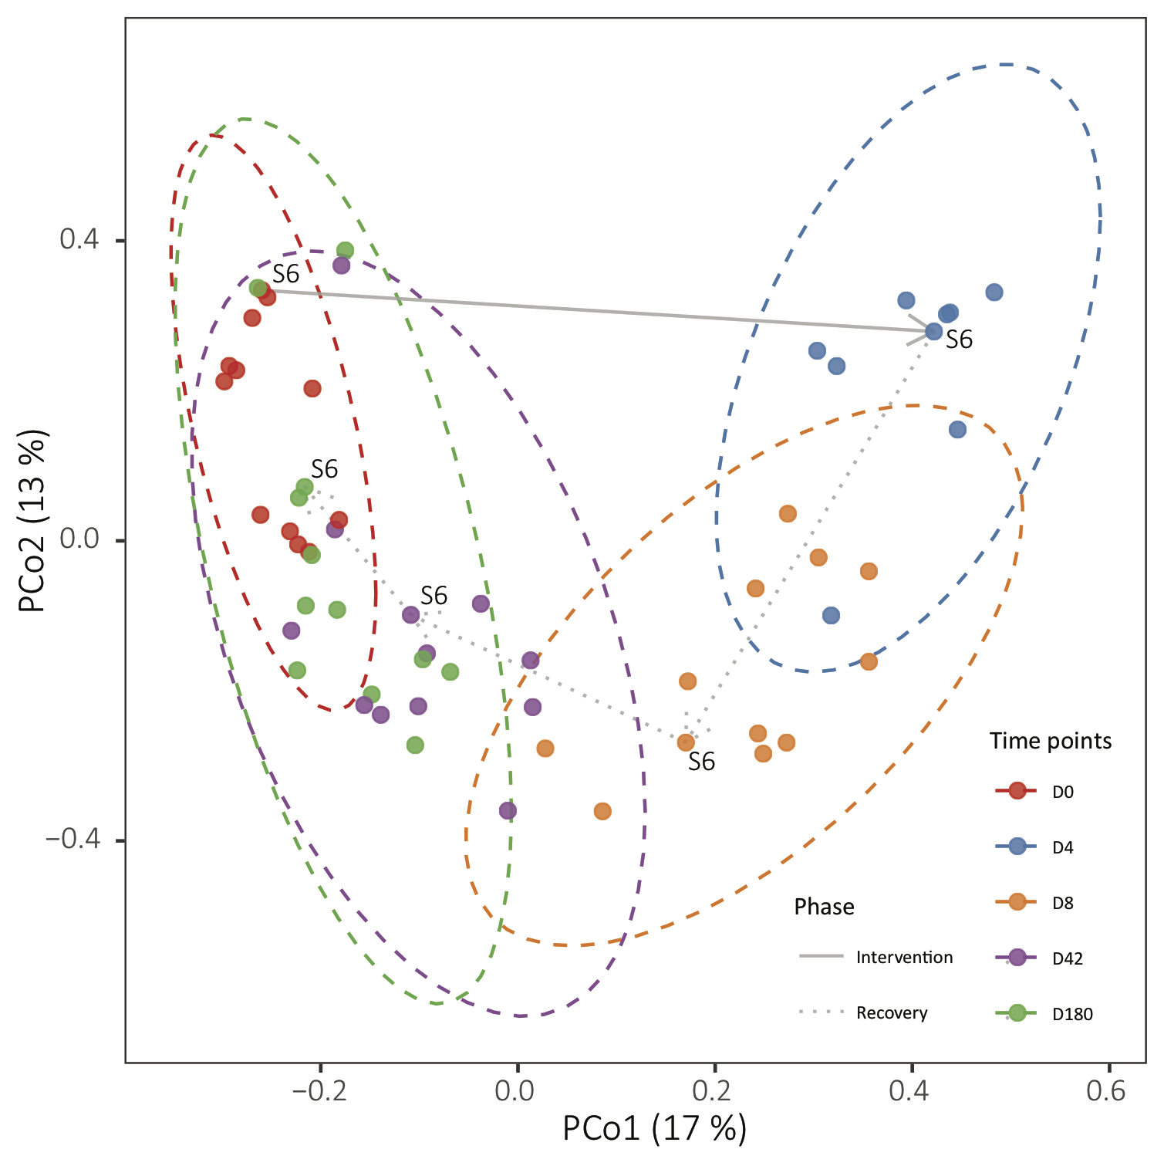
Diversity measures: Beta diversity
Diversity between samples (community composition dissimilarity)
For example:
Bray-Curtis dissimilarity (abundance-weighted)
Jaccard distance (presence/absence)
UniFrac (phylogenetic distances: weighted/unweighted)
These distances between samples are calculated based on the taxa abundance table and projected on the two first dimensions of a PCoA. (other ordination methods are also used: NMDS, tSNE or simply PCA,…)

Slide 26
Sumary table
 | Amplicon/16S sequencing | Shotgun metagenomics
 |  | Mapping - based | Assembly - based
Pros | Can handle low biomass / non-bacterial contamination Rough taxonomy of novel species Less expensive | High resolution (subspecies, genes SNVs) Can detect all DNA in the sample (also virus, fungus, protozoa,…) Fast and scales well Finds rare entities | High resolution (subspecies, genes SNVs) Can detect all DNA in the sample (also virus, fungus, protozoa,…) Can identify novel genomes, genes and synteny patterns
Cons | Low resolution Limited to bacteria or archaea No subspecies or strains resolution Biases due to PCR amplification / amplicon copy number variation | Does not work well for low biomass More expensive (currently very competitive prices) Limited to what is known in the databases | Does not work well for low biomass More expensive (currently very competitive prices) Misses rare entities Computationally very intensive

Slide 27
Examples of data analyses

Slide 28
Limitations
Cloning biases can lead to the misrepresentation of microbial DNA in metagenomic libraries.
Sampling biases can occur when collecting environmental samples which can also lead to misrepresentation of the microbial community.
Metagenomic sequencing can detect the presence of microorganisms but cannot easily determine if they are pathogenic.
The vast amount of metagenomic data requires faster and more scalable computational tools to handle the data efficiently.
Metagenomic datasets contain a mix of DNA from various organisms which often makes it difficult to assemble genomes accurately.
Contamination from host DNA or environmental sources can affect the accuracy of metagenomic analyses.
It is also challenging to extract genes from microorganisms present in low abundance within a sample.

